Slide 1
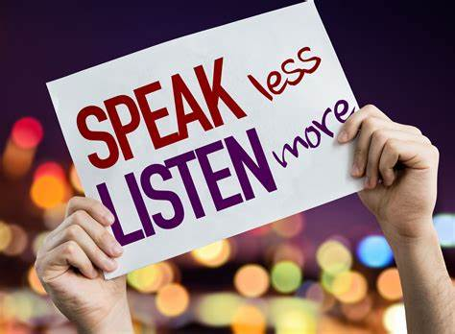
LISTENIG SKILL
Presentation by-
Pooja Bind

Slide 2
INTRODUCTION
Listening come first
Difference between Hearing and Listening
Definition of Listening and Listening Skills
Importance of Listening Skills
Types of Listening
Effective Listening
Feature of Listening
Process of Listening
Techniques of Listening Skills

Slide 3
Listening Comes First
The first and foremost communication skill that we learn in our life is nothing but “ LISTENING”.
LISTENING
SPEAKING
WRITING
READING

Slide 5
Difference between Hearing and Listening
HEARING | LISTENING
Hearing is simply the act of perceiving sound by ear. | Listening is an action where you choose to actively concentrate on what you here.
Hearing occurs with or without your consent. | In listening your brain processes the information into knowledge.
HEARING LISTENING
Hearing is simply the act of perceiving sound by ear

Slide 6

What is Listening?
The process of receiving, constructing meaning from , and responding to spoken and/or non- verbal messages; to hear something with thoughtful attention

Slide 7
Importance of Listening skills
An attentive listener stimulates better speaking by the speaker
A good listener learns more than an ordinary listener.
A good listener learns to detect prejudices, assumptions and attitudes.
Communication is not complete without effective listening.

Slide 8
Types of Listening
Discriminative Listening
Pretense Listening
Selective Listening
Attentive/Active Listening

Slide 9
Discriminative Listening:- It involves identifying the difference between various sounds. It also enables one to differentiate between familiar and unfamiliar language.
Active Listening:- -Active listening is a communication technique used in counseling, training, and conflict resolution. It requires that the listener fully concentrate, understand, respond and then remember what is being said..

Slide 10
Selective Listening:- It involves selecting the desired part of the message and ignoring the undesired part of the message.
Pretense Listening:- It involves more hearing than listening. It means pretending through facial expressions that one is listening when actually one is not

Slide 11
Active Listening
Actively Absorbing The Information Given To You By The Speaker, Showing That You Are Interested. It Can Also Include Providing The Speaker With The Feedback, By Asking Relevant Questions So The Speaker Knows The Message Is Received.
It is important to learn, to summarize and reflect smoothly, without appearing to mimic or repeat back in a robotic fashion. Useful phrases are: "As I understand it, what you are saying is ...." "So your point is that ...."

Slide 12
Benefits of Effective Listening
Enhances Productivity
Improves Relations
Avoids Conflict
Improves Understanding
Improves Negation Skills
Helps You Stand Out
People Will Appreciate It

Slide 13
Barriers of Effective Listening
Physiological Barriers 1)Hearing Impairment 2) Speaking Thinking Rate
Environment Barriers 1) Physical Distractions 2) Message Overload
Attitudinal Barriers 1) Prejudices 2) Preoccupation 3) A Casual Attitude 4) Egocentrism

Slide 14
Traits of a Good Listener
L = Look interested and get interested
I = Involve yourself by responding
S = Stay on target
E = Evaluate the message
N = Nuetrilise your feelings

Slide 15
THANK YOU

